Slide 1
Tutorial: Web Scraping in R
Find a group of 2-4 people to work together with (at least 1 person needs R Studio).
Please download this R notebook so you can follow along:
tinyurl.com/codingcafe1107
Brenden Eum
Coding Café
November 7, 2024
(Examples adapted from R for Data Science by Wickham et al.)

Slide 2
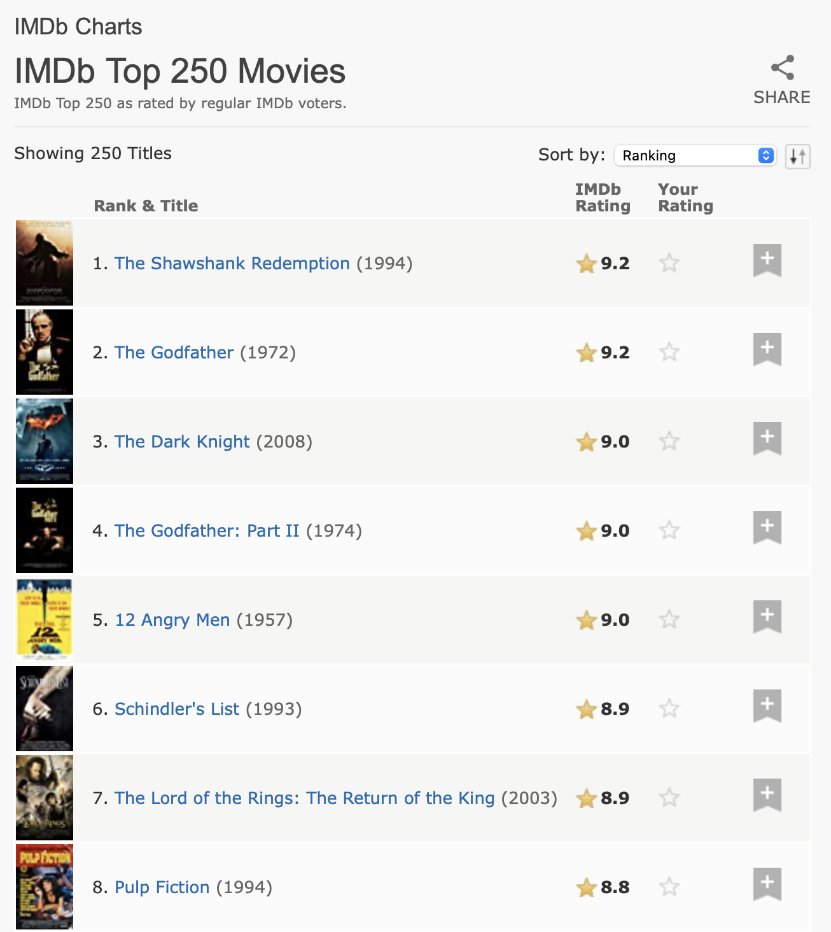

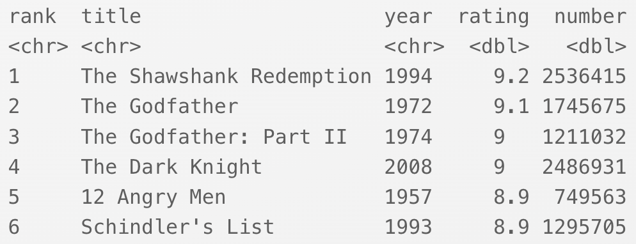
What is web scraping?
Web scraping is the process of extracting data from websites.

Slide 3


API
Web Scraping

Slide 4
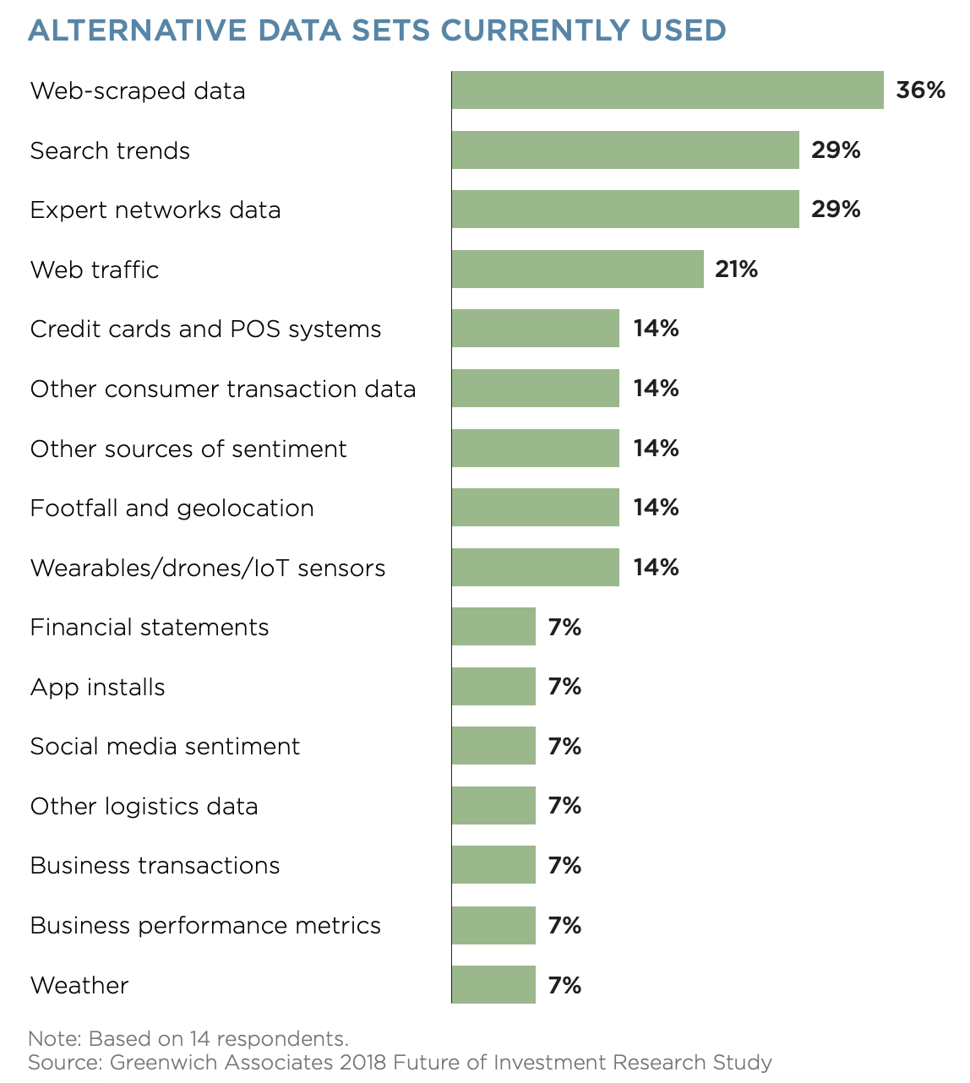
Why is this a useful skill to put on your resume?
Portfolio managers and investment analysts frequently use web-scraping to collect alternative data to gain a competitive edge.
(Source: Thomson Reuters)
Example use cases:
Market sentiment
Brand performance on retail websites
Data as a product
Discover trends on social media

Slide 5
Ethics and Legalities
3 VERY IMPORTANT questions to ask yourself before you scrape any data:

Slide 6
Ethics and Legalities
3 VERY IMPORTANT questions to ask yourself before you scrape any data:
Is the data public?

Slide 7
Ethics and Legalities
3 VERY IMPORTANT questions to ask yourself before you scrape any data:
Is the data public?
Is the data non-personal?

Slide 8
Ethics and Legalities
3 VERY IMPORTANT questions to ask yourself before you scrape any data:
Is the data public?
Is the data non-personal?
Is the data factual?

Slide 9

Ethics and Legalities
3 VERY IMPORTANT questions to ask yourself before you scrape any data:
Is the data public?
Is the data non-personal?
Is the data factual?
Yes
Yes
Yes

Slide 10
Ethics and Legalities
3 VERY IMPORTANT questions to ask yourself before you scrape any data:
Is the data public?
Is the data non-personal?
Is the data factual?
If the data is public, you are not likely to be bound to the company’s terms of service. This helps you avoid legal consequences.

Slide 11
Ethics and Legalities
3 VERY IMPORTANT questions to ask yourself before you scrape any data:
Is the data public?
Is the data non-personal?
Is the data factual?
If the data does not contain personally identifiable information (e.g. names, email addresses), it is non-personal. This helps you avoid ethical backlash if you publicize your data.

Slide 12
Ethics and Legalities
3 VERY IMPORTANT questions to ask yourself before you scrape any data:
Is the data public?
Is the data non-personal?
Is the data factual?
*Not the same thing as “Is it correct?”
Data is not protected under copyright law. As long as you limit your scraping to facts, you’ll generally be safe from legal action.

Slide 14
HTML

Slide 15
HTML
<html>
<head>
<title>This is a Title</title>
</head>
<body>
<h1 id='first’>This is a heading.</h1>
<p>This is some regular text and <b>some bold text.</b></p>
<img src='myimg.jpg' width='100' height='100'>
</body>

Slide 16
HTML
<html>
<head>
<title>Page title</title>
</head>
<body>
<h1 id='first'>A heading</h1>
<p>Some text &amp; <b>some bold text.</b></p>
<img src='myimg.png' width='100' height='100'>
</body>
Element: Sometimes it makes something on the webpage, sometimes it does something to the stuff inside of it…

Slide 17
HTML
<html>
<head>
<title>Page title</title>
</head>
<body>
<h1 id='first'>A heading</h1>
<p>Some text &amp; <b>some bold text.</b></p>
<img src='myimg.png' width='100' height='100'>
</body>
Tags: Are used to create elements.

Slide 18
HTML
<html>
<head>
<title>Page title</title>
</head>
<body>
<h1 id='first'>A heading</h1>
<p>Some text &amp; <b>some bold text.</b></p>
<img src='myimg.png' width='100' height='100'>
</body>
Tags: Are used to create elements.

Slide 19
HTML
<html>
<head>
<title>Page title</title>
</head>
<body>
<h1 id='first'>A heading</h1>
<p>Some text &amp; <b>some bold text.</b></p>
<img src='myimg.png' width='100' height='100'>
</body>
Contents: The tags are doing something to some stuff. Contents are that stuff.

Slide 20
HTML
<html>
<head>
<title>Page title</title>
</head>
<body>
<h1 id='first'>A heading</h1>
<p>Some text &amp; <b>some bold text.</b></p>
<img src='myimg.png' width='100' height='100'>
</body>
Attributes: You can think of these like names and extra options for elements.

Slide 21
HTML
Every HTML webpage will be in an HTML element!
<html>
<head>
<title>Page title</title>
</head>
<body>
<h1 id='first'>A heading</h1>
<p>Some text &amp; <b>some bold text.</b></p>
<img src='myimg.png' width='100' height='100'>
</body>

Slide 22
HTML
Inside of that HTML element are two “children” elements.
The head often contains information ABOUT the webpage, not the information presented IN the webpage (one exception is the page title).
<html>
<head>
<title>Page title</title>
</head>
<body>
<h1 id='first'>A heading</h1>
<p>Some text &amp; <b>some bold text.</b></p>
<img src='myimg.png' width='100' height='100'>
</body>

Slide 23
HTML
<html>
<head>
<title>Page title</title>
</head>
<body>
<h1 id='first'>A heading</h1>
<p>Some text &amp; <b>some bold text.</b></p>
<img src='myimg.png' width='100' height='100'>
</body>
Inside of that HTML element are two “children” elements.
The body contains information presented ON the webpage.

Slide 24
HTML
What are the elements you’re typically looking for?
<h1> headings
<section> sections
<p> paragraphs
<ol> ordered lists
<a> links
<table> tables
<html>
<head>
<title>Page title</title>
</head>
<body>
<h1 id='first'>A heading</h1>
<p>Some text &amp; <b>some bold text.</b></p>
<img src='myimg.png' width='100' height='100'>
</body>

Slide 25
Hands On: Notebooks

